Slide 1
מס' פרויקט:
20-1-1-2187
שם הפרויקט: מימוש וסימולציה של מאיץ למערכות לומדות על רכיב FPGA
מגישים: שי צבר 208723627 חיים גרודה 312562721 מנחה:
יוני זייפרט
מקום ביצוע:
אוניברסיטה

Slide 2
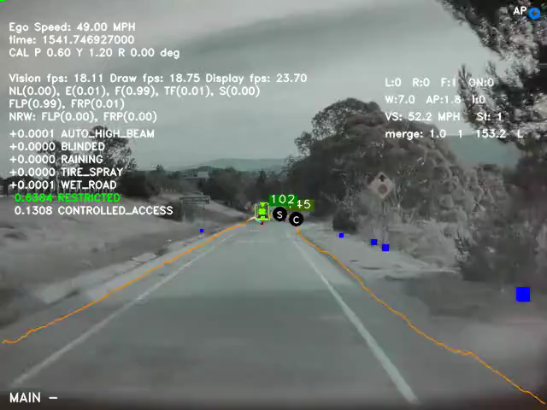
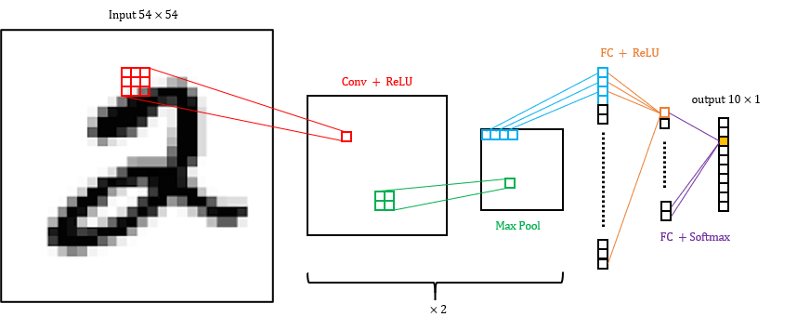
CNN – Convolutional Neural Network
Achieved great success in image classification, speech recognition and more.
Research hotspot in many scientific fields.
Widely used in the industry, such as for autonomous cars, security systems, health and more.
CNN Structure
Convolution - Feature extraction using filters
Activation – Introduce nonlinearity
Pooling - Reduce spatial dimensions
Fully Connected - Final classification decision
Video: Tesla computer vision
Figure: Implemented CNN model

Slide 3
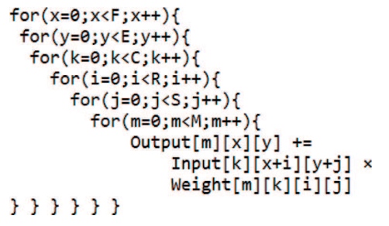
Motivation and Objectives
Motivation
High accuracy comes with high computation time. Approx. 90% of CNN computations are in the convolutional layers
Computation resources cause high-power consumption
Need to include such image recognition capabilities in embedded systems with tight real-time and power constraints
Objectives
Acceleration – by hardware parallelization
Accuracy – reduce loss due to fixed point arithmetic
Power – dedicated hardware processing elements
Figure: 2D convolution. [source]
Figure: Nested for loop for convolution calculation

Slide 4
Method
ZedBoard FPGA
Programmable logic
Control design optimization
Fast development
Fixed Point Calculations:
Better computation time
Less hardware resources
Possible loss of accuracy
High Level Synthesis (HLS)
RTL abstraction
Focus on functionality
Easily explore algorithmic changes
Simple platform retargeting
Simulation:
SW implementation of CNN
Comparison time HW vs SW
Compare accuracy HW vs SW
Evaluate power consumption

Slide 5
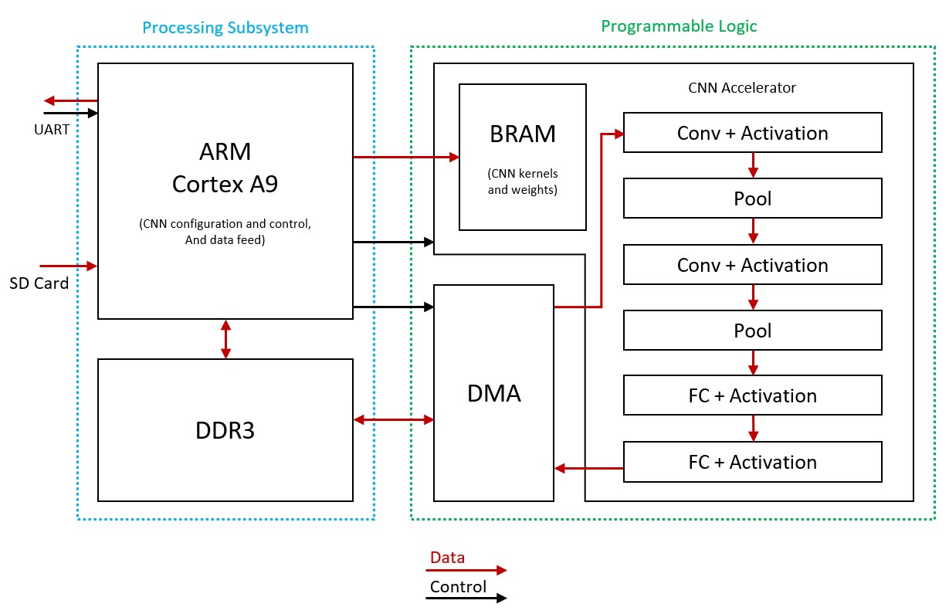
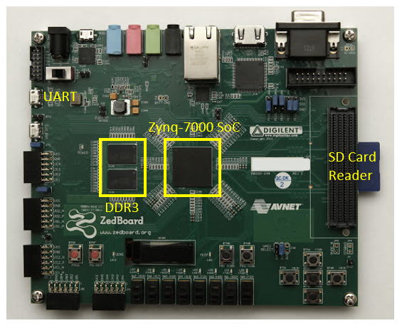
Hardware Design
Processing system (PS):
ARM Cortex A9 667MHz CPU
Input Output – SD card, UART
Control and configuration
DDR memory unit
Programmable Logic (PL):
Artix-7 FPGA with 6.6M logic cells
DMA controller for data transfer
Processing Element per CNN layer
BRAM for kernels and weights
AXI interfaces
Stream – high throughput (input data)
Lite – static data (kernel/weights)

Slide 6
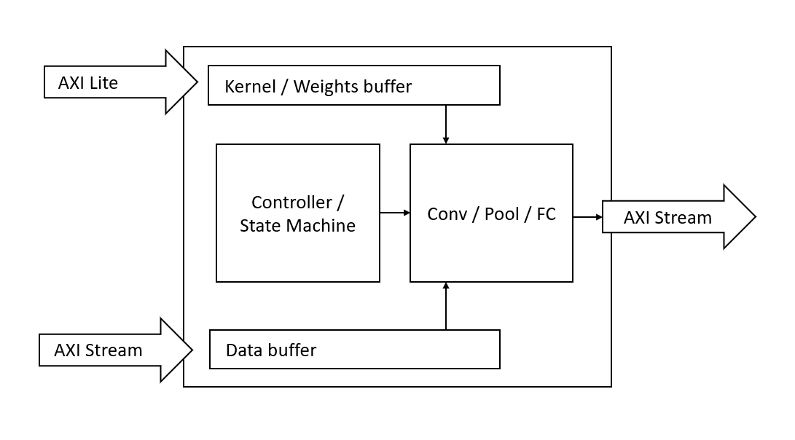
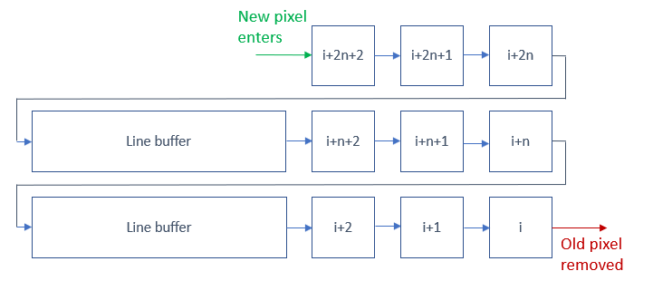
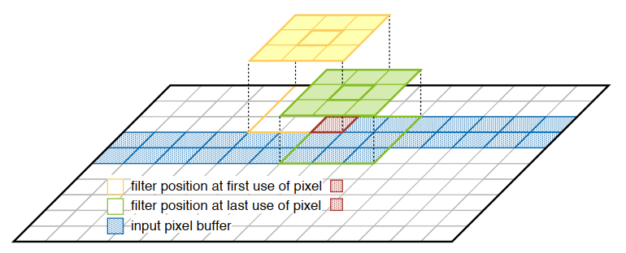
Hardware Design
Processing Element
Single CNN layer
BRAM buffers
FIFO implementation
Sliding Window
Neighborhood extraction mechanism
Memory utilization
Data reuse – pixel transferred only once
Figures: Data reuse / sliding window illustration
Figures: Processing Element design

Slide 7
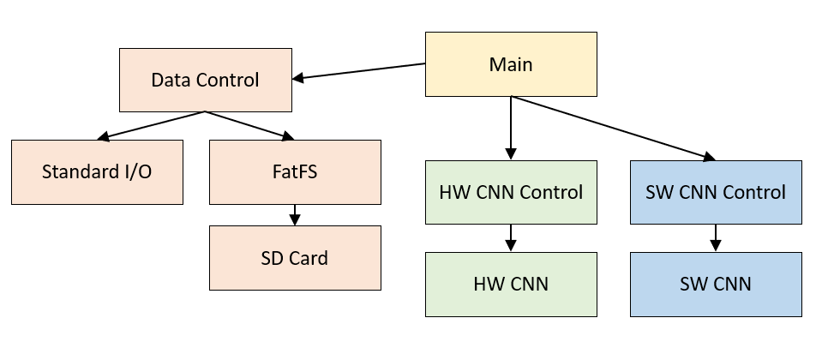
Software Design
Cross platform: PC and FPGA
Written in C in Vivado SDK
FPGA platform (ARM Cortex A9 CPU)
Bare Metal (no OS)
FatFS – Free file system software module
Maximum Stack (64Kb)
PC platform (Intel i7 CPU)
Linux based
Single threaded
Possible Simulation of HW calculations

Slide 8
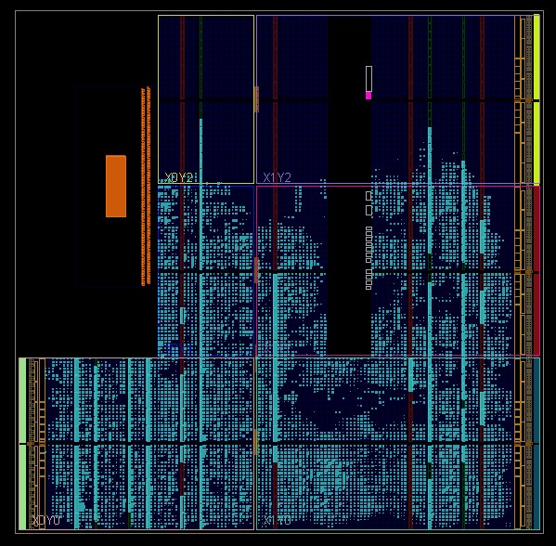
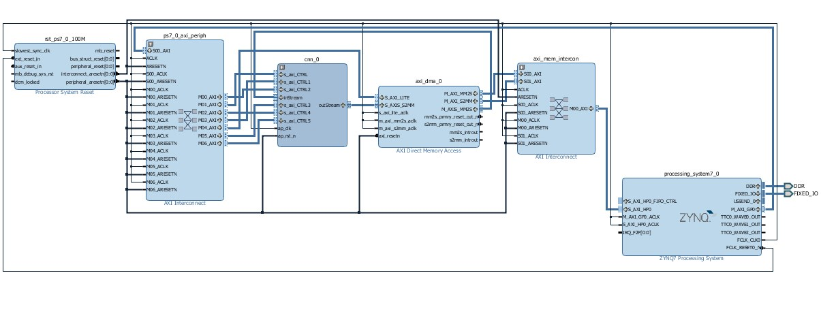
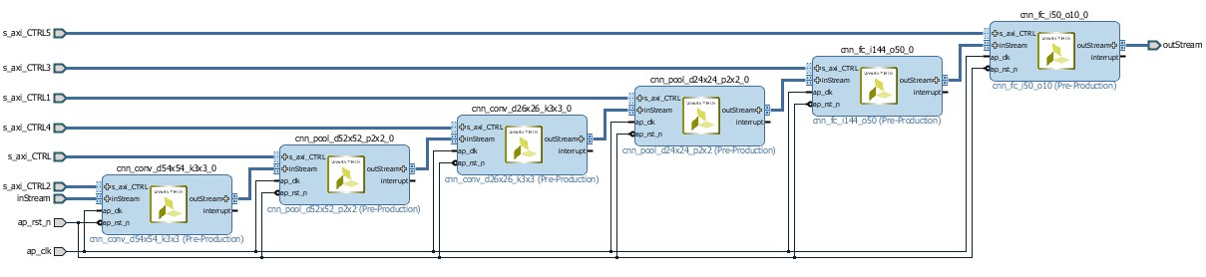
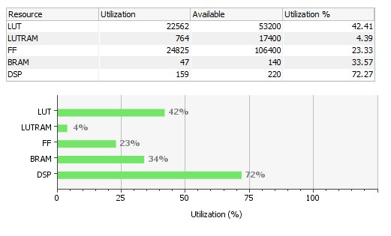
HW Implementation
CNN Core
DMA Engine
Processing System
Figure: TOP block design
Figure: Implemented Design
Table: FPGA utilization
Figure: CNN core block design

Slide 9
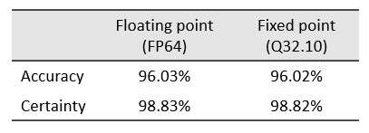
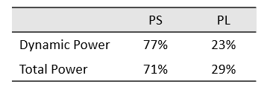
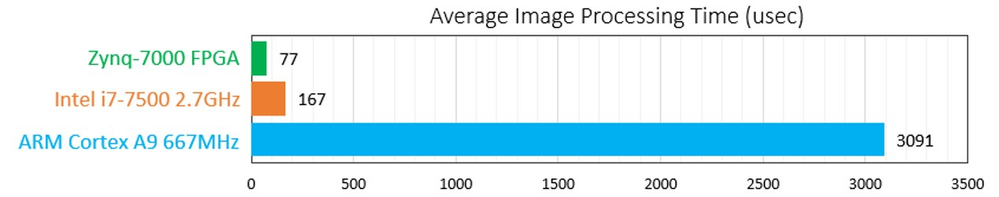
Simulation Results
CNN Simulation
Python Keras deep learning library
MNIST dataset, 10K test images
Kernels and weights fed to CNN
Table: CNN accuracy using different arithmetic
Measurements
Avg. image processing time
Avg. accuracy
Avg. certainty
Vivado power estimation
Table: Vivado power estimation results
Table: Time comparison

Slide 10
Conclusions and Future Work
Conclusions
Significant acceleration compared to SW
No loss of accuracy with fixed point
Significant power conservation
Future Work
Add convolution channels (RGB)
Compare with multi threaded SW implementations
Test accuracy loss for different fixed-point schemes

Slide 11
Appendix and References
Project repository on GitHub
ZynqNet - An FPGA-Accelerated Embedded CNN
Science Direct - Convolutional Neural Networks

